Slide 1
CAUSES OF AIR POLLUTION
Industries and automobiles make a major contribution towards causing air pollution.
14 000 cars are coming on to the roads per day per year.
Annually 5.5 million people are losing life due to air pollution world wide.
Annually 1.6 million people are losing life due to air pollution in China.
Annually 1.4 million people are losing life due to air pollution in INDIA.

Slide 2
Formation of pollutants can be prevented and their emission can be minimized at the source itself.
By carefully investigating the early stages of design and development in industrial processes e.g., those methods which have minimum air pollution po­tential can be selected to accomplish air-pollution control at source itself.

Slide 3
Control of air pollution
1. Source correction methods
A. Substitution of raw materials
B. Process modification
C. Modification of existing equipment
D. Maintenance of existing equipment
2. Diffusion of pollutant in air
3. Vegetation
4. Zoning
5. Pollution control equipment

Slide 4
1.Source correction methods
A. Substitution of raw materials
If the use of a particular raw material results in air pollution, then it should be substituted by another purer grade raw material which reduces the formation of pollutants.
Thus,
(a) Low sulphur fuel which has less pollution potential can be used as an alter­native to high Sulphur fuels, and,
(b) Comparatively more refined liquid petroleum gas (LPG) or liquefied natu­ral gas (LNG) can be used instead of traditional high contaminant fuels such as coal.

Slide 5
1 kg of uranium (U235) will produce 1500 tones of high grade coal equivalent energy
With a complete combustion or fission, approx. 8 kWh of heat can be generated from 1 kg of coal, approx. 12 kWh from 1 kg of mineral oil and around 24,000,000 kWh from 1 kg of uranium-235.
Related to one kilogram, uranium-235 contains two to three million times the energy equivalent of oil or coal.
The illustration shows how much coal, oil or natural uranium is required for a certain quantity of electricity.
Thus, 1 kg natural uranium - following a corresponding enrichment and used for power generation in light water reactors - corresponds to nearly 10,000 kg of mineral oil or 14,000 kg of coal and enables the generation of 45,000 kWh of electricity.

Slide 6
CO₂ Emissions per kWh energy generation at the source for various fuel as follows:
Coal – 0.98 kg of CO₂ /kWh
Including Transmission losses – 2.02 kg of CO₂ /kWh by coal
Compressed Natural Gas – 0.52 kg of CO₂ /kWh
Oil – 0.77 kg of CO₂ /kWh

Slide 7
Below is comparison of Current Fuel Prices in Delhi, (as on 2nd September 2014)
Petrol Rs. 68.51 / Lit
Diesel Rs. 58.97 / Lit
CNG Rs. 38.15 / Kg Gas
LPG Rs. 47.94 / Litre

Slide 8
Average Mileage for various fuels (in City)
13 to 14 Kmpl by Petrole
17 to 18 Kmpl by Diesel
19 Km/kg by CNG
12 Kmpl by LPG (liquefied petroleum gas)

Slide 9

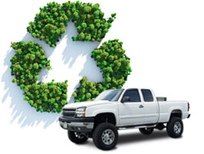
Advantages of CNG
Reduced Fuel Cost
Domestically Produced
Abundant Fuel
Environmentally Friendly

Slide 10
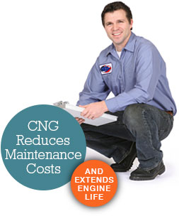
Reduced Maintenance Cost
Performance Advantages
Safety Advantage

Slide 11
Source correction methods…
B. Process modification
The existing process may be changed by using modified techniques to control emission at source. For example,
(a) If coal is washed before pulverization, then fly-ash emissions are consider­ably reduced.
(b) If air intake of boiler furnace is adjusted, then excess Fly-ash emissions at power plants can be reduced.

Slide 12
Source correction methods…
D. Modification of Existing Equipment:
Air pollution can be considerably minimized by making suitable modifications in the existing equipment:
(a) For example, smoke, carbon-monoxide and fumes can be reduced if open hearth furnaces are replaced with controlled basic oxygen furnaces or elec­tric furnaces.
(b) In petroleum refineries, loss of hydrocarbon vapours from storage tanks due to evaporation, temperature changes or displacement during filling etc. can be reduced by designing the storage tanks with floating roof covers.
(c) Pressurising the storage tanks in the above case can also give similar re­sults.

Slide 13
D. Maintenance of Equipment:
An appreciable amount of pollution is caused due to poor maintenance of the equipment which includes the leakage around ducts, pipes, valves and pumps etc.
Emission of pollutants due to negligence can be minimized by a routine checkup of the seals and gaskets.

Slide 14
2. Diffusion of Pollutants in Air:
Dilution of the contaminants in the atmosphere is another approach to the con­trol of air pollution.
If the pollution source releases only a small quantity of the contaminants then pollution is not noticeable as these pollutants easily diffuse into the atmos­phere but if the quantity of air contaminants is beyond the limited capacity of the environment to absorb the contaminants then pollution is caused.
However, dilution of the contaminants in the atmosphere can be accomplished through the use of tall stacks which penetrate the upper atmospheric layers and disperse the contaminants so that the ground level pollution is greatly re­duced.
The height of the stacks is usually kept 2 to 2¹/₂ times the height of nearby structures.

Slide 15
Dilution of pollutants in air depend on atmospheric temperature, speed and direction of the wind.
The disadvantage of the method is that it is a short term contact measure which in reality brings about highly undesirable long range effects.
This is so because dilution only dilutes the contaminants to levels at which their harmful effects are less noticeable near their original source whereas at a considerable distance from the source these very contaminants eventually come down in some form or another.

Slide 16
3. Vegetation:
Plants contribute towards controlling air-pollution by utilizing carbon dioxide and releasing oxygen in the process of photosynthesis.
This purifies the air (re­moval of gaseous pollutant—CO₂) for the respiration of men and animals.
Gas­eous pollutants like carbon monoxide are fixed by some plants, namely, Coleus Blumeri, Ficus variegata and Phascolus Vulgaris. Species of Pinus, Quercus, Pyrus, Juniperus and Vitis depollute the air by metabolising nitrogen oxides.
Plenty of trees should be planted especially around those areas which are de­clared as high-risk areas of pollution.

Slide 17


Slide 18
4. Zoning:
This method of controlling air pollution can be adopted at the planning stages of the city.
Zoning advocates setting aside of separate areas for industries so that they are far removed from the residential areas.
The heavy industries should not be located too close to each other.
New industries, as far as possible, should be established away from larger cities (this will also keep a check on increasing concentration of urban population in a few larger cities only) and the locational decisions of large industries should be guided by regional planning.
The industrial estate of Bangalore is divided into three zones namely light, medium and large industries.
In Bangalore and Delhi very large industries are not permitted.

Slide 19
5. Pollution Control Equipment:
Sometimes pollution control at source is not possible by preventing the emission of pollutants.
Then it becomes necessary to install pollution control equip­ment to remove the gaseous pollutants from the main gas stream.
The pollutants are present in high concentration at the source and as their distance from the source increases they become diluted by diffusing with envi­ronmental air.

Slide 20
Pollution control equipment
If pollution control at source is not possible then we have to treat the pollutants being emitted.
a. Control devices for particulate contaminants
1. gravitational settling
2. cyclone separators
3. fabric filters
4. electrostatic precipitators
5. wet collectors
i) spray tower ii) venturi scrubber iii) cyclonic scrubber
b. Control devices for gaseous contaminants
1. wet absorption methods
2. dry absorption methods

Slide 21
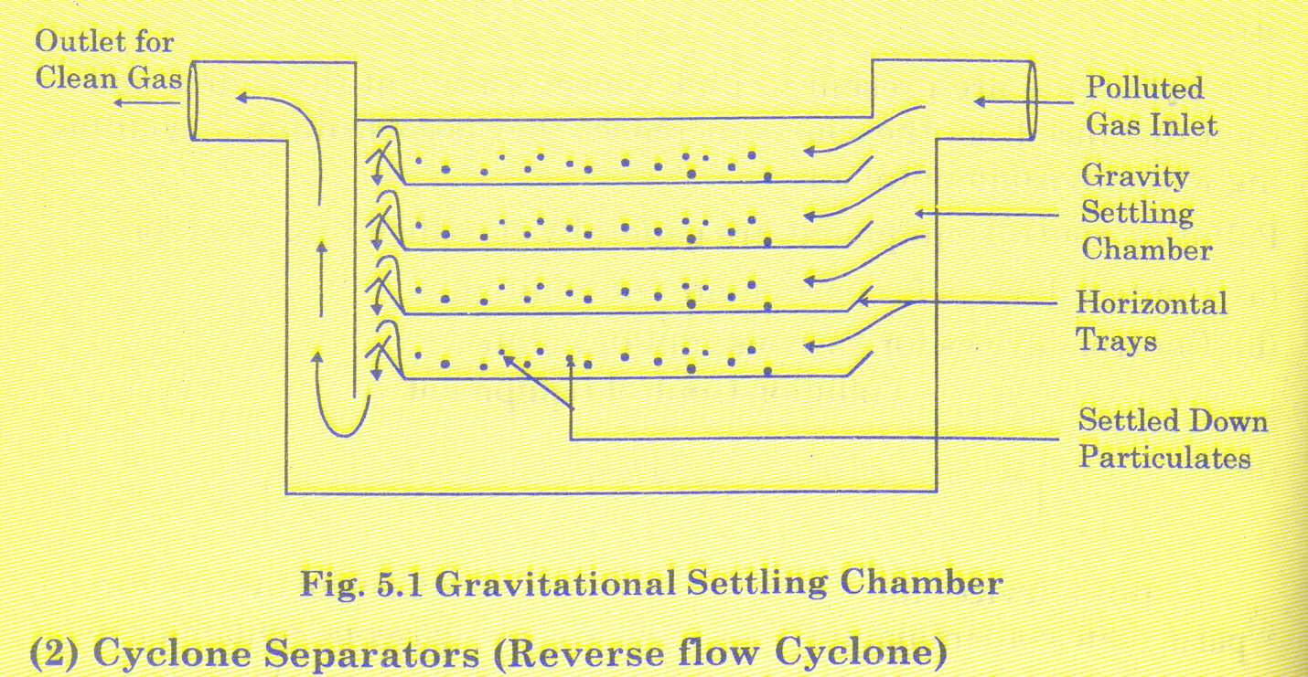
1. Gravitational settling chamber
For removal of particles exceeding 50 µm
Polluted gas stream enter from one side of the chamber
Horizontal velocity of gas stream is low (< 0.3 m/s) in order to give sufficient time for particles to get settled.
Particles having higher density settle at the bottom

Slide 22
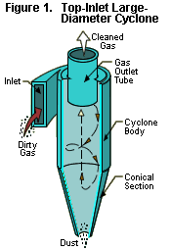
2. Cyclone separators
Centrifugal force is utilized to separate particulates
Centrifugal force several times greater than gravitational force can be generated by a spinning gas stream.
Hence it can remove even smaller particulates not removed by gravitational separator.
Dust laden gas (dust loaded gases) enter tangentially and receives a rotating motion.
Due to centrifugal force developed particulates are thrown to the walls of the separator and gas spirals upward inside the cone.
Particulates slide down the walls of cone and are discharged

Slide 23
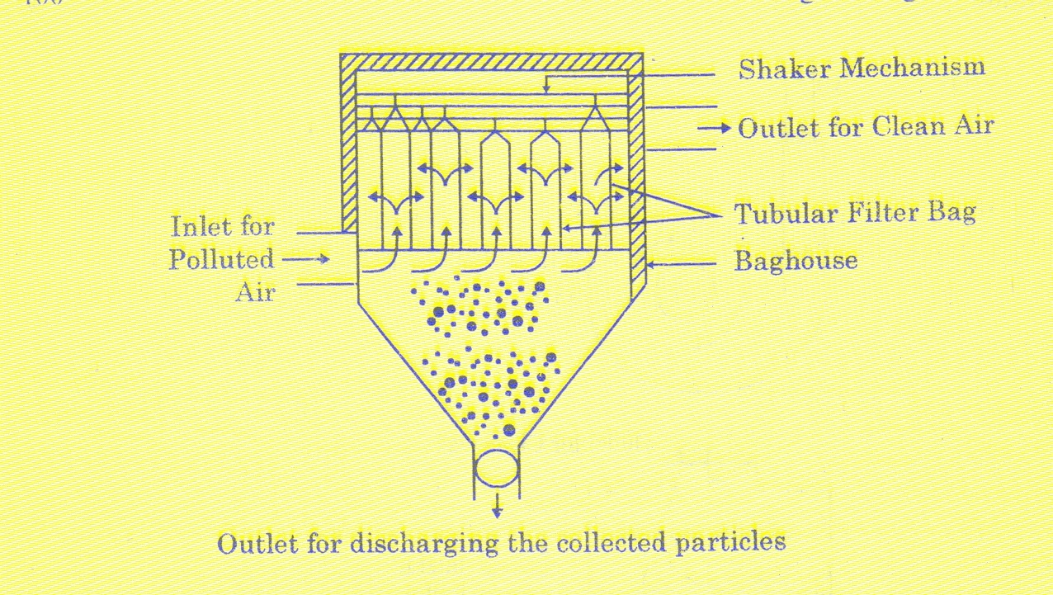
3. Fabric filter
Stream of polluted gas is made to pass through a fabric that filters out particulates
Particulate matter left in the form of a thin dust mat on the insides of the bag acts as a filtering medium for further removal of particulates
This helps to remove even sub micron particles (0.5 µm)
Must be cleaned occasionally to prevent too many particulate layers from building up on the inner surfaces of the bag.

Slide 24
HEPA Filter
High Efficiency Particulate Absorbing/Particulate Arresting
Can theoretically remove 99.97% of dust, pollen, bacteria or any airborne particles with a size of 0.3 µm.
Composed of a mat of randomly arranged fibers with airspace between the fibers greater than 0.3 µm.
They trap particulates by 3 mechanisms:
1. interception: particles following one line of flow come within one radius of a fiber and adhere to it.
2. impaction: due to curving contours of air stream larger particles are unable to avoid fibers and will adhere to one of them.
3. diffusion: particles below 0.1 µm collides with gas molecules and are delayed in their path through the fiber. This increases the probability that the particles are stopped by any one of the above mechanism.
Appln: Nuclear fuels and Nuclear power generation industries to prevent spread of airborne radioactive contaminants.

Slide 25
4. Electrostatic precipitator
Electrically charged particulates are separated under the influence of an electric filed.
A high voltage is applied (50 kV)
Gas enters from bottom and when gas enters the electric filed will get ionized.
-ve ions migrate to grounded electrode, giving their –ve charge to the dust particles.
-vely charged dust particles move to +ve electrode and get deposited there.
It has 99% efficiency

Slide 26
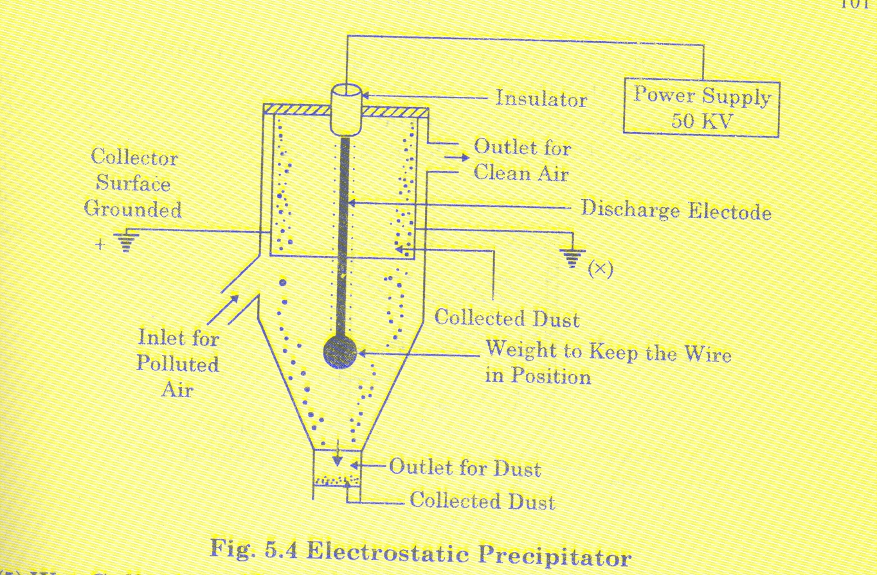
Contd..

Slide 27
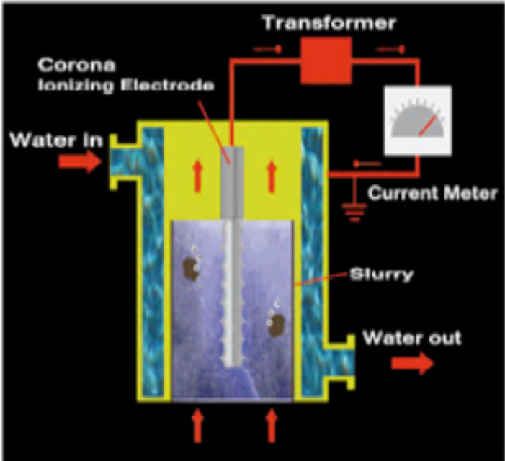
Condensing WESP
Condensing Wet Electrostatic Precipitator has a water jacket around the positively charged tube wall.
Water jacket causes condensation of moisture in gases thus maintaining a constant water film to wash the surface.
Water film prevents particulate build up on collection surface.

Slide 28
5. Selective Catalytic Reduction (SCR)
Gaseous or liquid reactant (ammonia or urea) is added to the flue gases and is absorbed onto a catalyst.
It is similar to coagulation method of water treatment.
Reductant (REDUCING AGENT ) reacts with NO_{x} and form H₂O and N₂.
A vanadium based catalytic converter is commonly used.
But SCR catalutic converters work well only in a small temp. range. So flue gas temp. monitored by the ECU.
Ammonia slip can occur if:
1. exhaust gas temp is too cold for SCR reaction to occur.
2. ECU supplies too much ammonia into exhaust stream than reqd. for the NO_{x} present.

Slide 29
6. Wet Scrubber
Used to remove/neutralize harmful contaminants in the flue gas.
It works via the contact of target compounds or particulate matter with scrubbing solution.
Solution may be water (for dust) or complex reagents for specific compounds.
Removal efficiency improved by increasing residence time of pollutants in scrubber or by increasing surface area of scrubber solution.
Increase in surface area is achieved by:
1. Spray tower: water is introduced from top. Droplets greater than 10 µm are carried and get settled at the bottom
2. Venturi scrubber
3. Cyclone scrubber

Slide 30
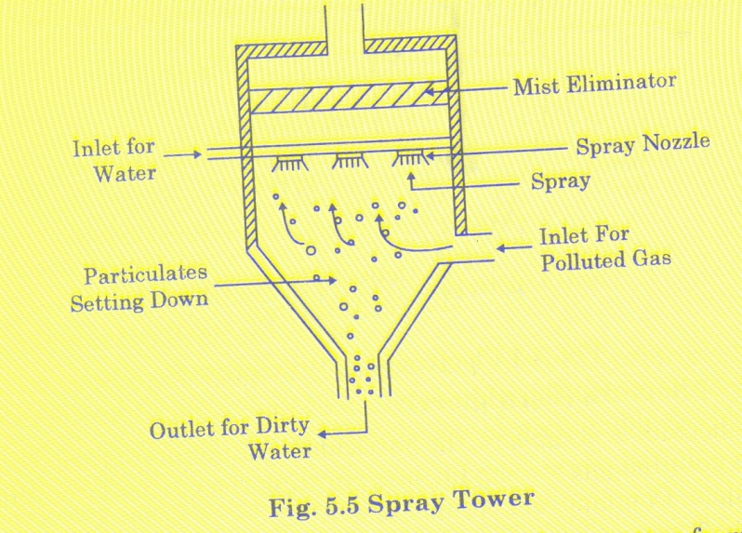
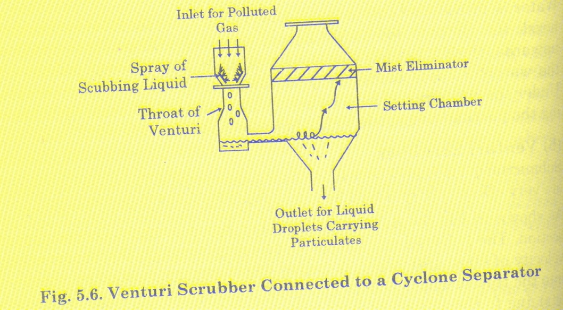
Venturi scrubber
Submicron particles (0.5 to 5 µm) in smoke and fumes are removed.
Polluted gases pass through venturi shaped throat at the velocity of 60 – 180 m/s.
Coarse water stream is injected upwards into the throat where it gets atomized due to impact of high velocity gases.
Liquid droplets collect particulates as they collide.
To separate droplets carrying particulate matter from the gas stream, this gas-liquid mixture is passed through a cyclone separator.

Slide 31
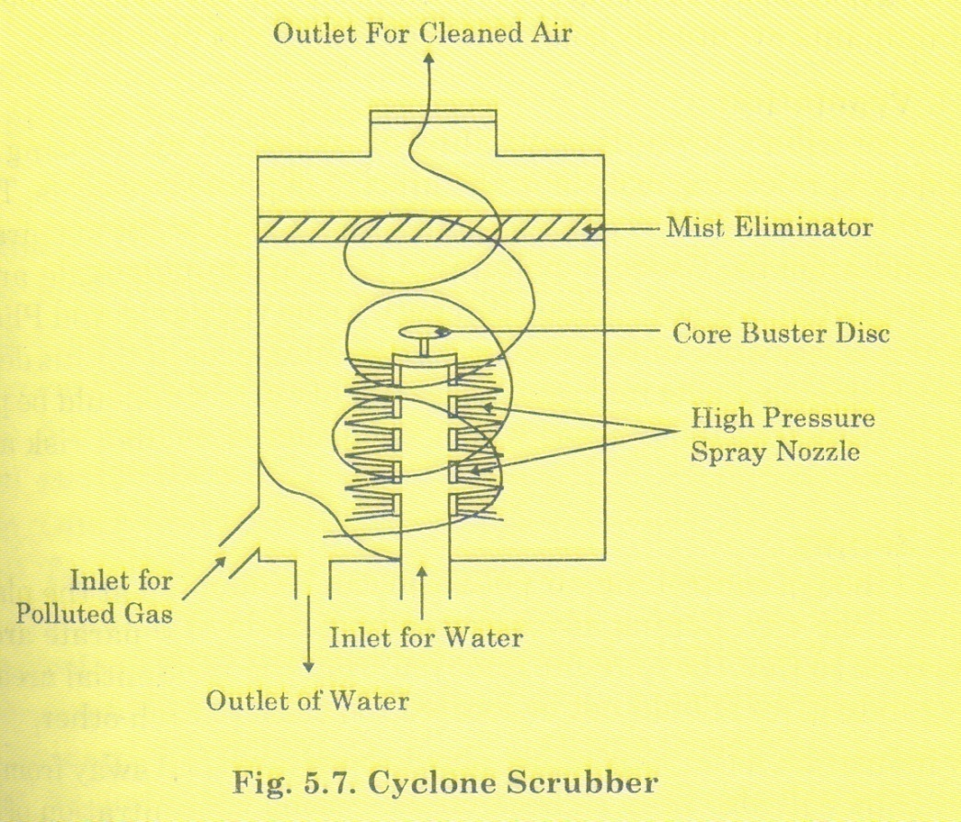
Cyclone scrubber
Dry cyclone chamber can be converted to wet cyclone scrubber by inserting high pressure spray nozzles at various places.
High pressure spray nozzles generate fine spray that intercepts the small particles in the polluted gas.
Centrifugal force throws these particles towards the wall from where they are drained downwards.
One side effect of scrubbing is that the contaminants removed from gas, which now are in solid form should be properly contained or buried to prevent further pollution.

Slide 32
7. Flue Gas Desulphurisation
It is the current state-of-the art technology used for removing SO₂ from flue gases coming out of power plants using fuels like coal.
SO₂ is removed by:
1. wet scrubbing using a slurry of sorbent, usually limestone or lime, to scrub the gases.
2. spray-dry scrubbing using similar sorbent slurries
3. Dry sorbent injection
Since SO₂ is an acid gas, the sorbent slurries should be alkaline.
When wet scrubbing is done with CaCO₃ (limestone-slurry), CaSO₃ (calcium sulfite-solid) and CO₂(gas) is formed.
When wet scrubbing is done with Ca(OH)₂ (lime-slurry), CaSO₃ (calcium sulfite-solid) and H₂O(liquid) is formed.
Wet scrubbing uses a high energy liquid stream to contact the gas stream and effect mass transfer.

Slide 33
Gas Flare
An elevated vertical stack or chimney found in oil wells, rigs, chemical plants, refineries, etc., to burn unusable waste gas or inflammable gas released by the pressure relief valves.
Flaring and venting of natural gas in oil wells is a main source of green house gases.
100 billion cubic meters of natural gas is flared or vented annually.
It is equivalent to combined annual gas consumption of Germany and France.

Slide 34
Photochemical smog
Conditions for formation of photochemical smog are air stagnation, abundant sunlight and high concn. of HC and NO_{x} in atm.
Smog arises from photochemical reactions in the lower atmosphere by interaction of HC and NO_{x}. This interaction results in a series of complex reactions which may produce secondary pollutants like ozone, ketones, aldehydes and peroxyacyl nitrates.
NO₂ absorb UV light from sun forming nitric oxide and highly reactive atomic oxygen.
Atomic oxygen immediately combines with molecular oxygen to form ozone.
Under normal circumstances O₃ reacts with NO to form NO₂.
But when HC is present in atm NO reacts with hydrocarbon radical peroxyacyl (RCO₃) and results in building up of O₃ concn in atm.
Hydrocarbons react with atomic oxygen to form acyl radical (RCO).
Acyl radical react with molecular oxygen to form RCO₃.
Peroxyacyl radical reacts with HC, NO and O₃ to form aldehydes, NO₂ and Ozone.

Slide 35
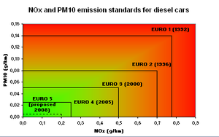
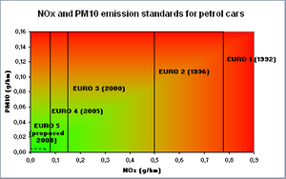
EURO Norms

